Slide 1
Team Members & Roles [Team4Hack – 57]
NAME | ROLES
Kaushik Dutta | Leading the team, generating the core ideas for the datathon, and also contributing by editing the video to ensure the final output aligns with the project vision.
Sudipta Biswas | Handle the presentation for the datathon, organizing the project details in a clear and compelling format to showcase during the event.
Jeet Saha | Responsible for creating the video presentation, ensuring the project is visually engaging and communicates the key points effectively.
Sohini Das | Assist and support the entire project, ensuring all tasks run smoothly and providing help wherever needed throughout the process.

Slide 2

[Raksha]
The AI-Enabled Emergency Safety Assistant(AIESA)

Slide 3



Problem Statement
Challenges for Individuals: In emergencies (accidents, disasters, medical crises), people often cannot access timely, effective help due to communication breakdowns and event complexity.
Current Gaps: Emergency response systems often struggle with delays, miscommunication, and lack of context-aware assistance during unpredictable, high-stress events.
Challenges for First Responders: Managing large-scale emergencies is difficult due to overwhelming data, coordination issues, and the need for fast, informed decision-making.
Need for Innovation: Existing systems lack real-time, adaptive support that accounts for the unique circumstances of evolving crises.

Slide 4

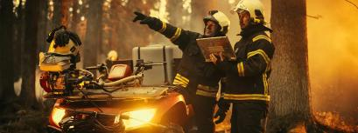
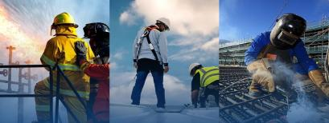

Problem Statement
People in distress may struggle to communicate their exact location, the nature of their emergency, or other vital details, further complicating rescue efforts.
Remote Workers in High-Risk Professions Problem: Workers in isolated or high-risk professions (e.g. delivery drivers, healthcare workers, journalists) may face threats of violence, theft, or accidents while working alone.
Thus, the challenge is clear: How can we enhance the speed, accuracy, and effectiveness of emergency response systems using technology, while ensuring that this solution is scalable, accessible, and adaptable to various contexts?

Slide 5

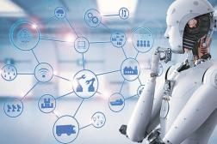

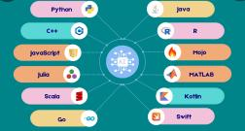
Solution
RAKSHA allows users to set personalized emergency protocols, including predefined contacts, preferred response methods, or specific actions that the app should take automatically in case of an emergency.
The AI-Enabled Emergency Safety Assistant (RAKSHA) offers a cutting-edge solution to modern emergency response challenges. RAKSHA integrates advanced AI technologies such as real-time data analytics, machine learning, and predictive algorithms to assist emergency services.
Beyond reacting to emergencies, RAKSHA proactively offers safety advice based on environmental and situational data, helping users avoid potential dangers before they occur.
RAKSHA utilizes AI, particularly Natural Language Processing (NLP), to allow victims to summon help through voice commands without needing to physically unlock or interact with their phone.
RAKSHA uses Machine Learning (ML) to continuously learn from user behavior and sensor data, enabling it to automatically detect unusual patterns like sudden falls or abnormal movements without requiring manual input.
Technology used Android SDK,Kotlin/Java,TensorFlow Lite, AWS, GPS and Geofencing, Figma/Adobe XD, OAuth 2.0, Speech Recognition Libraries, WebSockets, Firebase Analytics.

Slide 6

Wow factors!
Location Tracking and Alerts: RAKSHA automatically detects the victim's location and sends this information, along with real-time photos, to designated guardians or emergency contacts, ensuring swift action and support.
Real-time, Context-Aware Responses: RAKSHA can assess and understand emergency situations in real-time, providing tailored assistance based on the specific circumstances of each crisis.
AI-Driven Intelligence: Using advanced AI technologies, RAKSHA analyzes data from various sources (wearables, smartphones, sensors) to detect emergencies and respond without manual input.
Stealth Mode Activation: In an emergency, RAKSHA can discreetly turn off the phones screen while automatically sending crucial information to guardians, ensuring the users safety without alerting potential threats.
Customizable Trigger Patterns: Allowing users to set their own secret activation pattern makes the app more personal, adaptable, and difficult for potential attackers to figure out.
Automatic Evidence Collection: The app automatically starts recording voice notes, takes camera footage, and logs critical data like location. This ensures that no moment goes undocumented, offering strong evidence for any legal or investigative needs.

Slide 7
Here's the video presentation of our project Raksha. https://drive.google.com/file/d/18eYJjMZh_BKeQ6nFBdA_yawOB6a83mrx/view?usp=drivesdk

Slide 8

Learnings during the Datathon.
Cybersecurity: Understanding encryption, data protection, and threat modeling.
App Development: Optimizing system resources and designing modular, scalable architecture.
User-Centric Design: Creating an intuitive interface and stealth activation for emergencies.
Device Integration: Leveraging sensors, GPS, cameras, and APIs for real-time functionality.
Legal Considerations: Handling data privacy, ethics, and regulatory compliance.
Edge Cases: Anticipating failures like no internet or low battery and building fail-safes.
Real-Time Communication: Implementing push notifications and live location sharing.
AI/ML: Integrating ethical AI for features like distress detection.
Collaboration: Working in agile teams and managing cross-functional collaboration.
These learnings improved my technical, design, and problem-solving skills.

